Slide 1
COLLEGE MANAGEMENT SYSTEM
BY YUVASHREE S

Slide 2
INTRODUCTION
This project demonstrates the creation and management of a College Database System using SQL. It includes the design and manipulation of core relational tables such as students,courses and enrollment representing a basic academic environment. Through a series of DDL (Data Definition Language) and DML (Data Manipulation Language) operations, the system supports student enrollments, grading, performance ranking, and data access control. Advanced SQL concepts like joins, subqueries, window functions, views, triggers, and user privileges are applied to ensure data integrity, analytical insights, and security against threats like SQL injection.

Slide 3
Objectives
To design a relational database for managing student, course, and enrollment data.
To implement SQL operations such as INSERT, UPDATE, DELETE, and JOIN for real-time data manipulation.
To apply advanced SQL functions like RANK, GROUP BY, and WINDOW FUNCTIONS for performance analysis.
To enhance data integrity using constraints, triggers, and foreign keys.
To explore database security by creating user roles and preventing SQL injection.

Slide 4
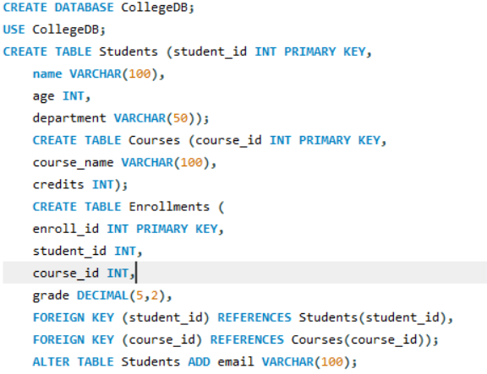
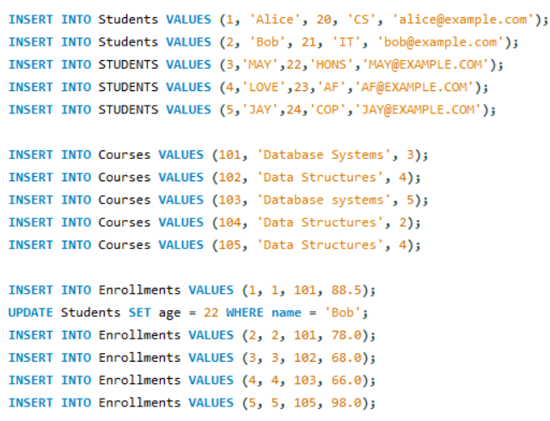
CREATION AND INSERTION OF DATA

Slide 5
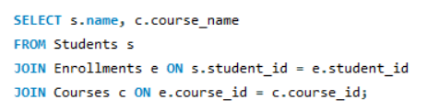
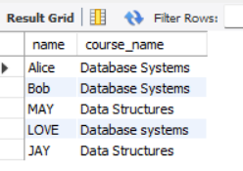
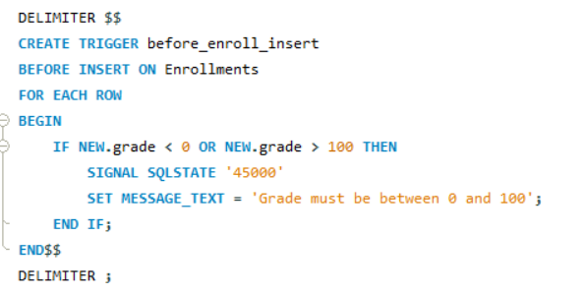
QUERY FOR INNER JOIN & ITS OUTPUT
DELIMITER
In SQL, especially in MySQL, the DELIMITER Command is used to change the default command separator.
WHY DO WE NEED IT?
By default, SQL uses ; (semicolon) to end a statement.
But when you're writing stored procedures, functions, or triggers, you often need to use semicolons inside your code block.
To avoid confusion, we temporarily change the delimiter to something else like $$ OR //.

Slide 6
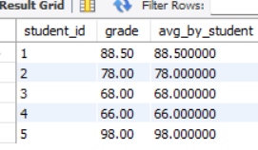

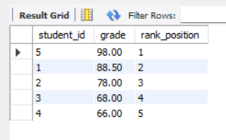

WINDOWS FUNCTION& RANK FUNCTION:
Window Functions Perform Calculations Acrsos Rows That Are Related To The Current Row, Without Removing Any Data.
Rank Function : Assigns A Ranking To Rows Based On A Specified Column, Usually For Sorting Or Performance Comparison. Unlike GROUP BY Window Functions Keep All Rows Visible In The Result.

Slide 7


TRUNCATE & DROP FUNCTION
Truncate: clear all the table
Drop : delete the table
GRANT IN SQL – GIVING PERMISSIONS
The grant command is used to give access/permission to users so they can do certain actions in the database (like reading or writing data).
SYNTAX

Slide 8
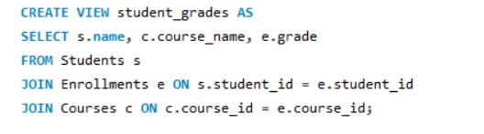
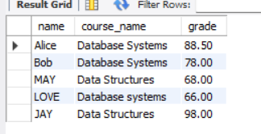
VIEW FUNCTION
A VIEW is like a virtual table — it shows the result of a stored SQL query.
It doesn’t store data itself
It pulls data from real tables whenever you use it

Slide 9
ADVANTAGES OF THIS STUDY
Improved Database Design Skills – You learned to build structured databases using proper tables and relationships.
Hands-on with Advanced SQL – Practiced real-world concepts like views, triggers, and window functions.
Better Data Analysis – Used SQL to calculate ranks, averages, and summaries, useful for performance analysis.
Data Integrity & Validation – Applied triggers and constraints to keep data clean and valid.
Access Control & Security – Learned to manage user permissions and prevent SQL injection risks.

Slide 10
CONCLUSION
This study provided a strong foundation in relational database management and SQL programming. By designing and managing a College Database, I gained practical knowledge in creating tables, inserting and modifying data, and applying complex SQL operations such as joins, views, window functions, and triggers.
I also learned how to use data validation, enforce data integrity, and apply user access control to enhance security. This hands-on experience has not only improved my technical skills but also prepared me for solving real-time data challenges in the field of data analytics and database management.

Slide 11
THANK YOU

